Slide 1
My Retirement Project
Recycled House Heat
Norman Desrosiers, ASME
North Carolina

Slide 2
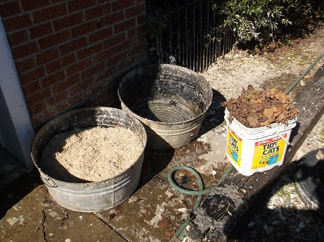
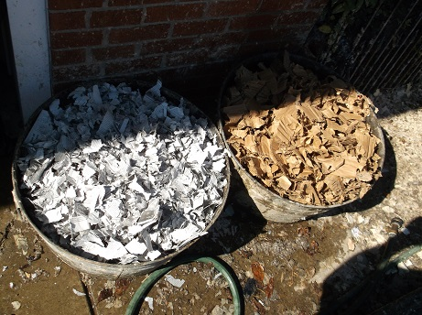
Primary Mix=newspaper, cardboard, hardwood sawdust, leaves, coffee grounds.

Slide 3
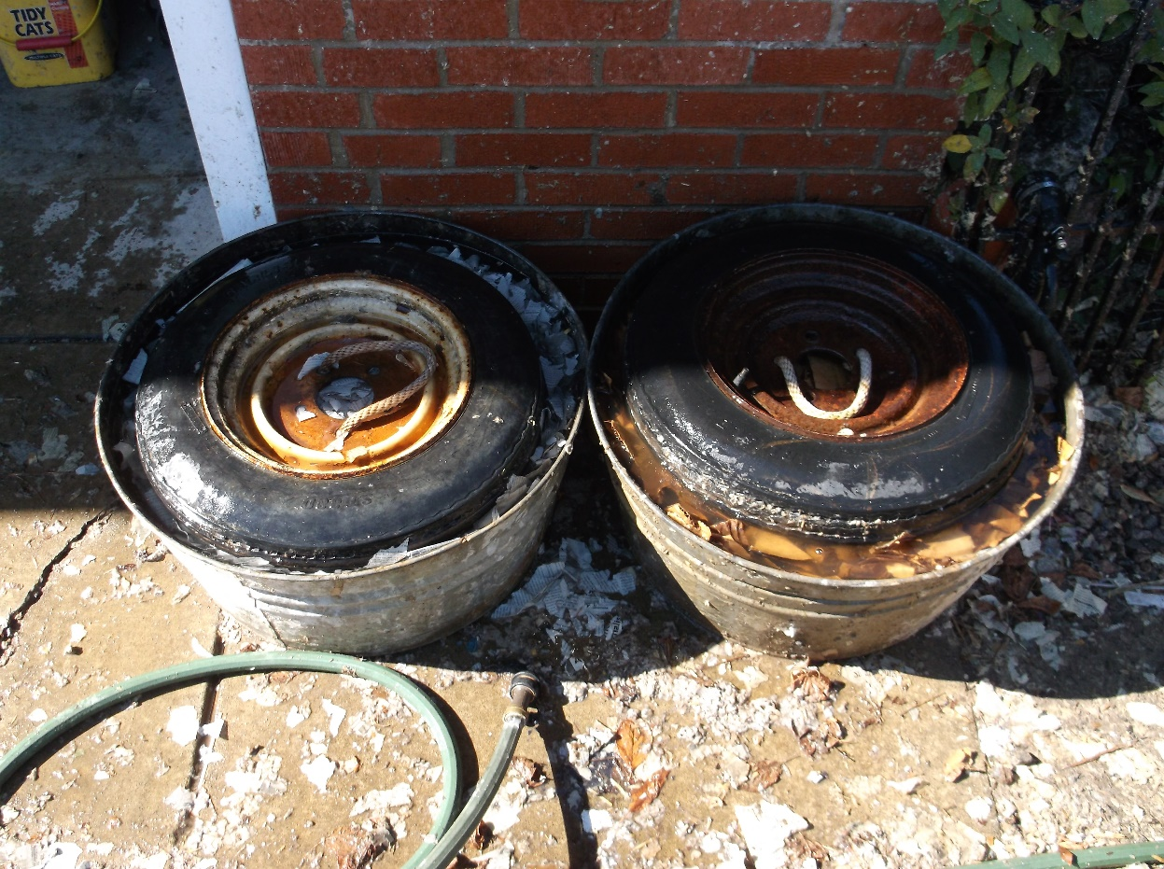
Soak Mix 24 Hours, add ½ cup detergent to each batch first. Use tire to hold shredded paper down. Grind into pulp with drill & mixer (saw blade on rod).

Slide 4
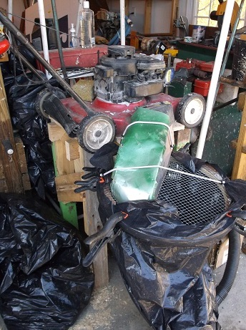
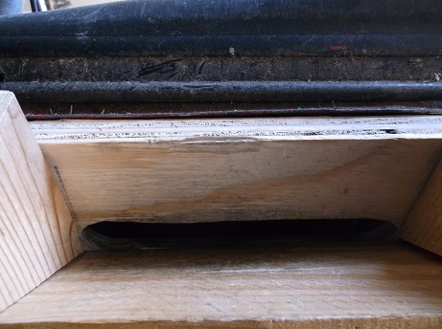
Dry paper & cardboard is shredded with a lawnmower on a stand. Discharges into leaf bag. Mower was not altered. Feed slot is ¾ wide underneath for safety.

Slide 5
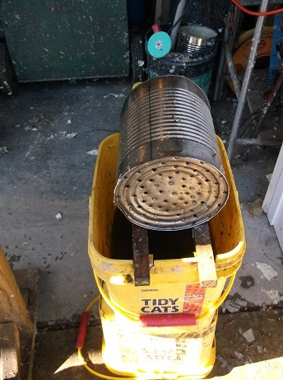
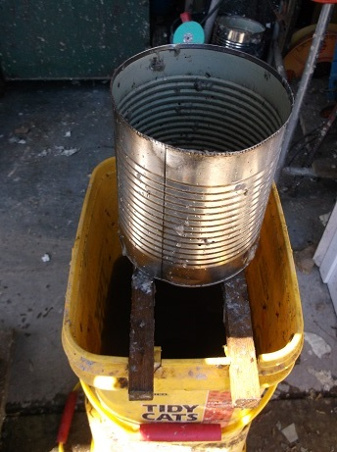
Mush is scooped into a 1 gallon can and set to drain between each press cycle. Water can be reused.

Slide 6
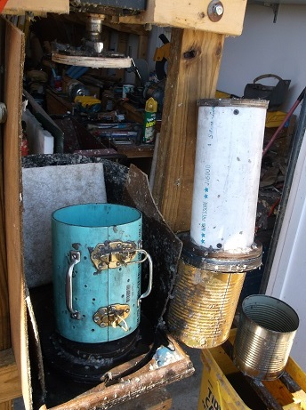
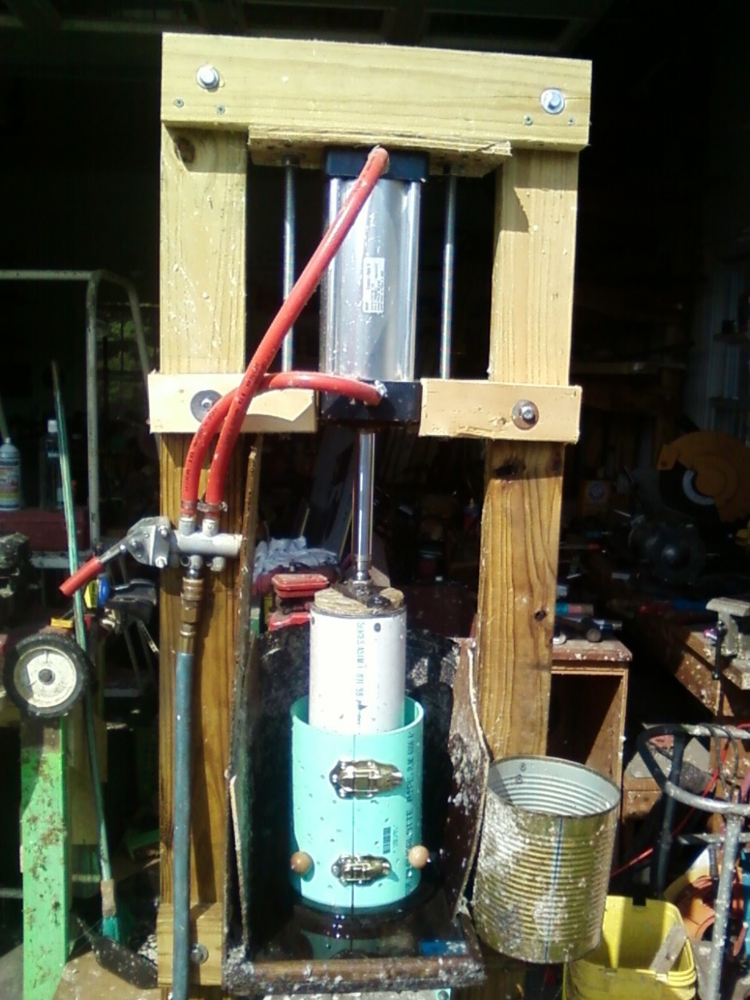
I gal mush will just fill split mold. Insert ram and put into pneumatic press. Cycle 2 minutes. See next slide for warning.

Slide 7
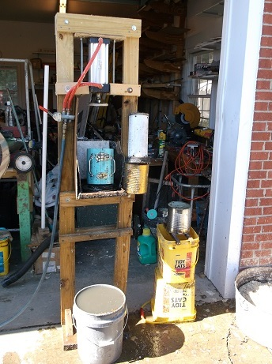
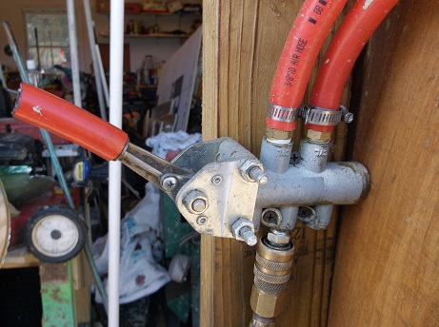
Caution, ram must be lowered slowly or pressure (900lb @ 100psi) will lift mold off the base, a mess. A proper 5-port valve should be used.

Slide 8
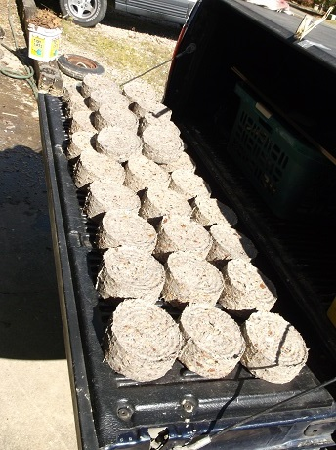
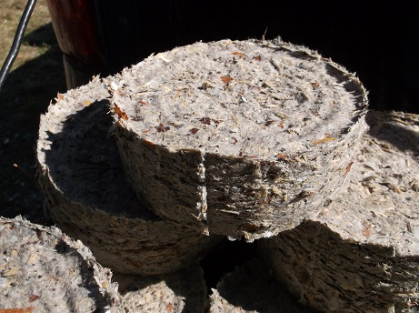
Retract ram, undo mold latches, hold handles and lift mold over briquette and ram. Remove ram, get briquette and set aside. Replace mold on base, close latches, refill with mush, and start new cycle.

Slide 9
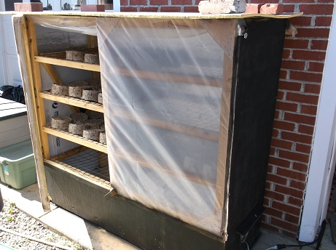
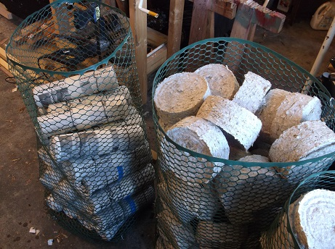
When all mush is used, put briquettes into drying cabinet to dry. Cabinet has a small fan/heater running 24/7 on low. Drying takes 3 days. Store in open baskets for more drying till used.

Slide 10
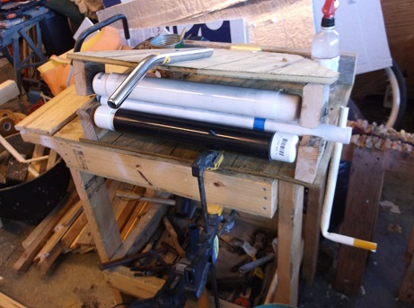
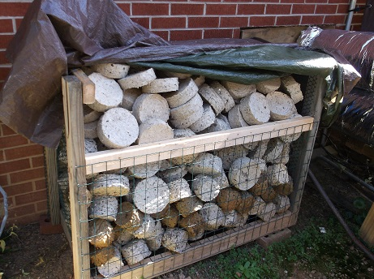
As you can see, I also make rolled logs. I put a little used motor oil on each paper as it is rolled. Here is my rolling machine I made. The storage baskets are plastic chicken wire put together with hog rings.

Slide 11
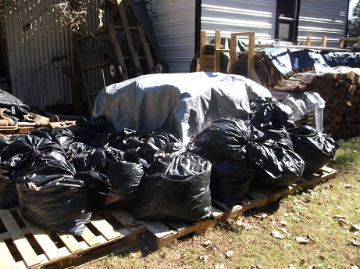
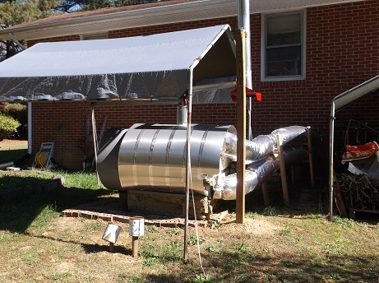
I’ve made a lot of briquettes, 32-34 a day. Here is a picture of my homemade outside heater I use them in. It just blows hot air into my basement.

Slide 12
A little additional info:
The press in made from treated wood and a 4 in. Dia. X 8” stroke double action air cylinder off of E-Bay. It gives about 900 lb @ 100 psi shop air. The mold is a 6” dia. plastic pipe from Lowes, drilled for drainage. The mold base is plywood, 2 pcs. The ram is 4” schedule 40 pipe with plywood ends. The pressing end is a piece of 1/2 foam between two wood disks to act as a O-ring under pressure and prevent water squirting out the top. Shielding must be placed around the mold or you will drench everything in a 6’ radius. As stated before, it is important to bring the ram down slowly to prevent blowouts. A simple on-off valve will not do this, get one for a double acting cylinder. Guides held align the mold directly under the cylinder or the frame can break. Use 2x4 min., 2x6 is better. Bolt it together.
I have a variety of molds I’ve experimented with, 4” and 6” diameter. All work. Some press the briquette out using a base under the mold but the split mold works fastest. Note it is only split in one place. Secure the draw latches with 3/16 pop rivets from the inside ( the heads will not interfere with the ram that way).
I also have a log making press that uses a trailer jack for the force. It works very well, producing a 4 x 4 x 18 log. It is just slower to use.
The drying cabinet was made from my outside drying racks I initially used, covered with foam board and plastic. It uses a little 115V room heater on low. Much more dependable than sunny weather, works at night and in the rain.
If you need fire starters, dip a few DRY briquettes into used motor oil and set aside. They will soak it up like a sponge.
Storage is my biggest problem. I set the baskets of briquettes on free pallets and covered well with a plastic tarp. Most of my stuff I had, the paper was free from a print shop (more than I could use from dumpster). Have fun above all.

